Slide 1

HEC Generative AI Training
Training Program - Cohort 3
Cohort 1
Module 5: What is Agentic AI, AI Agent?
Nov 17-2025

Slide 2
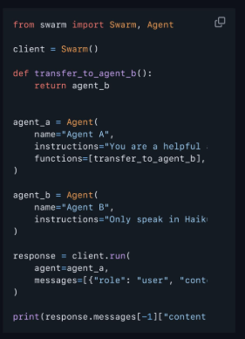
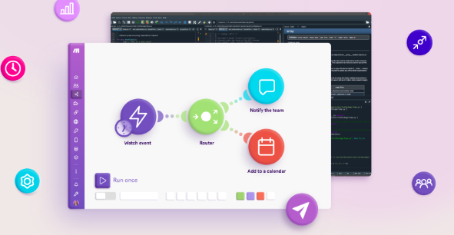
Modern Frameworks
Using Code
LangGraph
OpenAI SDK
Crew AI
NO-CODE
N8N
Zapier
OpenAI Agent Kit

Slide 3
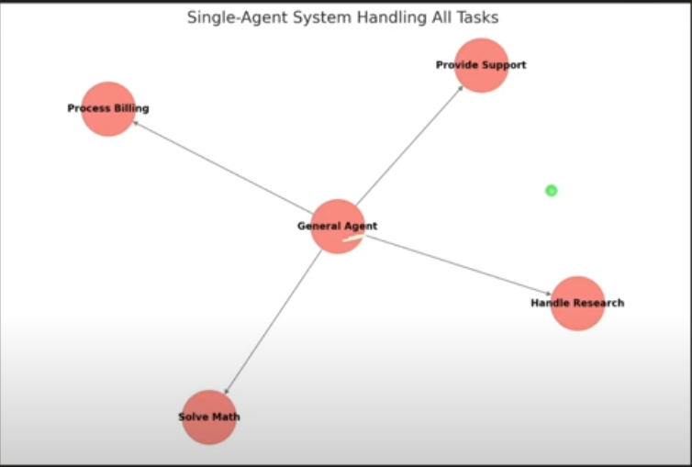

Slide 4
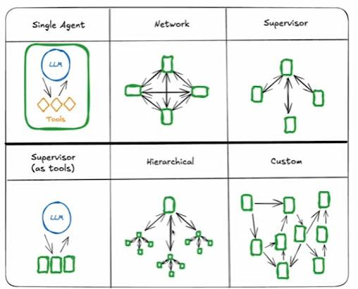
Several Multiple Agents Networks

Slide 5
Agenda of General Multiple Agents System 🎯
In a general context, the agenda of a multiple agents system is to leverage a network of specialized AI agents to collaboratively solve complex tasks or provide tailored services. Key objectives include:
Task Specialization: Each agent focuses on a specific role (e.g., decision-making, data processing, or execution) to handle diverse aspects of a problem efficiently.
Collaboration and Coordination: Agents work together, often with a central coordinator (e.g., triage or manager agent), to share information and optimize outcomes.
Adaptability: The system adapts to various inputs or scenarios by dynamically assigning tasks to the most suitable agent.
Efficiency and Scalability: Distributing tasks across agents reduces workload on a single entity, enabling scalability and faster processing.
Enhanced Problem-Solving: Combining agent expertise (e.g., reasoning, tool use, memory) leads to more comprehensive and accurate solutions.
User-Centric Design: The system provides a unified interface, delivering seamless, context-aware responses to users.

Slide 6
Tech companies offer Multiple agents network development
Besides OpenAI, companies like Google (via Gemini and Vertex AI), Microsoft (Azure AI agents), Anthropic (Claude-based agents), Amazon (AWS Bedrock agents), IBM (Watson Orchestrate), Meta (Llama agents), and Nvidia (AI workflows) offer multi-agent development frameworks as of 2025.

Slide 7
LLM = The BRAIN 🧠
Example: Any LLM (ChatGPT, Claude, Grok, etc) is like a brain of whether its a single agent or multiple agent system.
The LLMs can understand & generate language.
Note:
One LLM can be used across all agents, as in some code where Gemini handles guardrail, triage, math, and history. It's not necessary for each agent to have its own LLM; sharing one is efficient and common.

Slide 8
Prompt Management
Prompt management simictions or requests you give to AI like "Write me a poem". Prompts
Prompt management means making sure the AI understands the instructions correctly.
It controls how we ask the AI questions or give tasks, like using examples or clear formats to help it understand better.

Slide 9
Practical No 02
Hands on practice with N8N & Crew AI
Powered By: Muhammad Ibrahim Qasmi

Slide 10

Feel free to ask!

Slide 11
